Slide 1
SIGNLL Spring ‘24 Meeting 1
Sumeet and James
Notes:
yay🎉

Slide 2


Join the Discord!
Notes:
Not sure how people would even be here without the Discord, but just in case

Slide 3
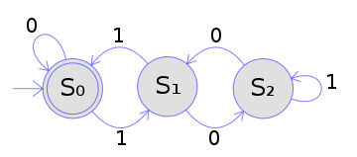
RegEx and Regular Languages
Regular Expression:
(0|1(01*0)*1)*
Regular languages:
Languages that are representable by Regular Expressions (or DFAs/NFAs)
Very useful, but can’t represent all languages
0^{n}1^{n}
Palindromes
Notes:
We love 173/374 :D

Slide 4
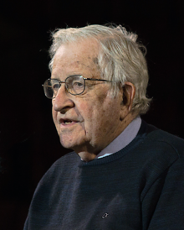
Grammars (briefly)
Context Free Grammars
Includes set of rules to construct syntactic units which can then form sentences
Also includes lexicon/vocabulary of words to choose from
Can include recursive rules!
Used in NLP to parse sentences into trees, disambiguation tasks, language detection, etc.
Used for other problems like document structure, data validation, and programming languages
Notes:
Shoutout the boy Noam

Slide 5
Context Free Grammars
Four parts:
Variables
Terminals
Production Rules
Start Symbol
G = {V, Σ, P, S}

Slide 6
Basic Example
G =
{{S, A, B},
{0, 1},
{S -> 0A | 1B1, A -> 0A | 1B1, B -> 0B0 | 1B1 | ε},
S}
Notes:
{S, A, B} are the variables, {0, 1} are the terminals, {S -> 0A | 1B1, A -> 0A | 1B1, B -> 0B0 | 1B1 | ε} are the production rules, and S is the start symbol

Slide 7
Basic Example cont.
S
0 A
1 B 1
01001
0 B 0
ε
Notes:
This grammar could also generate strings like 000000011, 1001, 00011100111, etc.

Slide 8
Parts of Speech
Noun (N)
Person, place, thing, abstraction (e.g. car, Simon, romanticism)
Pronoun (N)
Can replace a noun in a sentence (e.g. he, she, they, you)
Verb (V)
Action/state (e.g. eat, dismantle)
Adverb (Adv)
Modifies a verb (e.g. quickly, awfully, amazingly)
Preposition (P)
Relates a noun/pronoun with another entity (e.g. in, on, alongside)
Determiner (Det)
Modifies nouns (e.g. the, a, an)
Complementizer (C)
Signifies embedded clauses (e.g. if, whether, that)
Notes:
Very useful to know for part of speech tagging

Slide 9
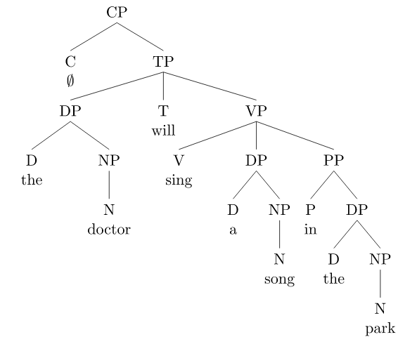
Notes:
For more info on syntax that looks like this, look into x-bar theory.

Slide 10
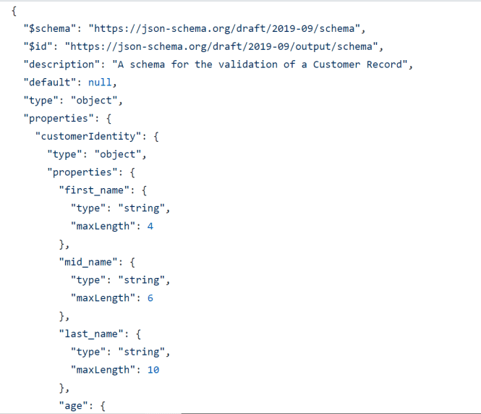
Notes:
This is a JSON schema. It’s used to specify JSONs to make sure they match certain requirements. They are highly flexible and pretty interesting imo.

Slide 11

Projects!
https://forms.gle/zQyiK1mCmW75hNst5
Notes:
rahhhh

